Slide 1

IoT Based Real Time Water Quality Monitoring System
Group Member:
Attiq ur Rehman
Muhammad Faizan
Project Advisor:
Dr. Safeer Hyder
Assistant Professor
Department of Electrical Engineering,
Sukkur IBA University

Slide 2
Problem Statement
The traditional system to determine water quality is not reliable.
It rely on collecting water samples, testing and analyses in water laboratories that is costly and time consuming.
Human errors can occur and may not provide accurate result.
It lack capability for real-time data capture, analyses and stakeholders can’t do fast dissemination on information for making timely and appropriate decisions.

Slide 3
Aims:
Designing a Real Time IoT Based Water Quality Monitoring System
Objectives
An open-source system development of water monitoring
Reduce import cost
Improve local capacity building

Slide 4
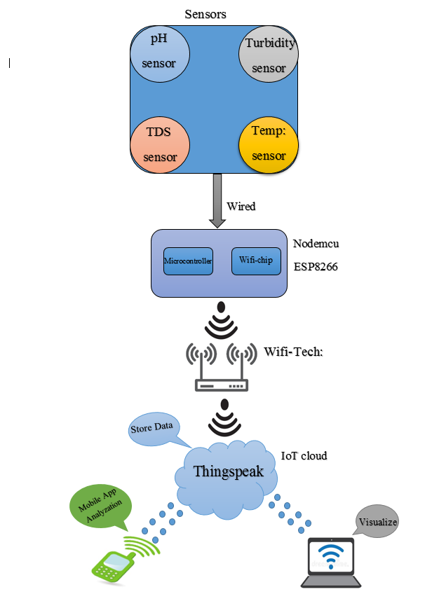
Proposed Solution
Designing a Real Time IoT Based Water Quality Monitoring System

Slide 5
Applications
Maintain a continuous healthy water supply
Fish pond water quality testing
Industrial Waste Cleaning purpose

Slide 6
What we have done so far?
Literature Review
Ignite Funding
Develop User Friendly Android App
Manage the Project on GitHub
Sensors Interfacing with Arduino/ESP8266
Data Visualization & Monitoring on Dashboard
Data Shifting to Cloud
IoT Platform Selection
Test sensors at Different Liquid samples
Email Alert

Slide 7
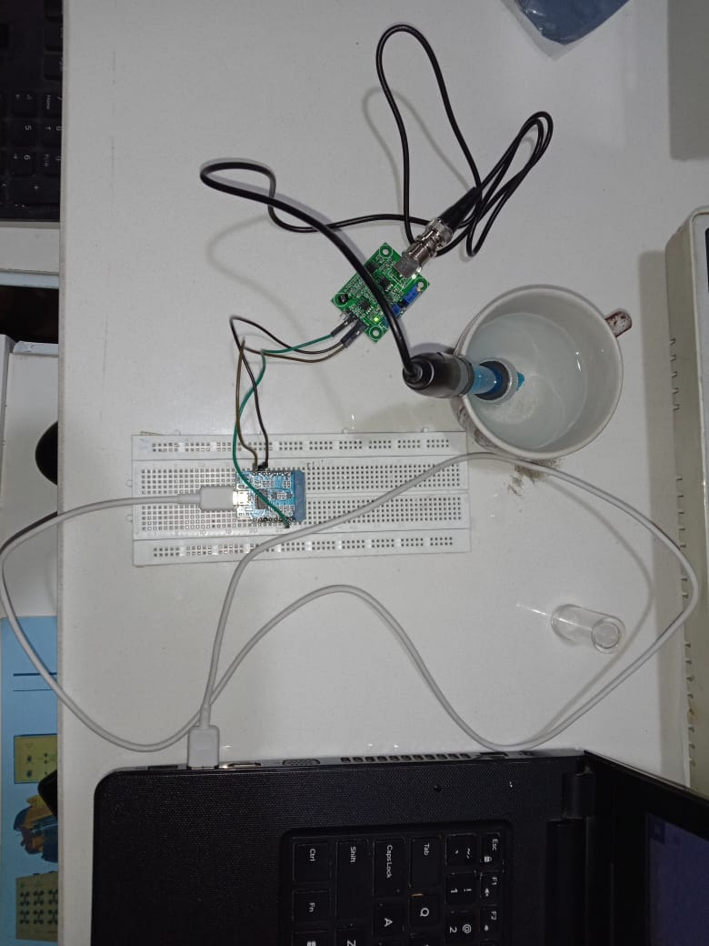
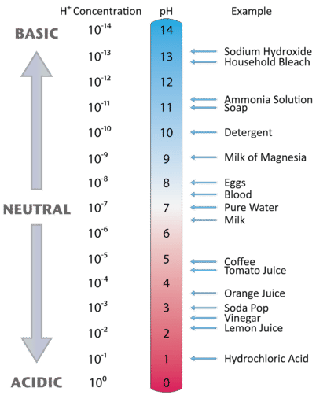
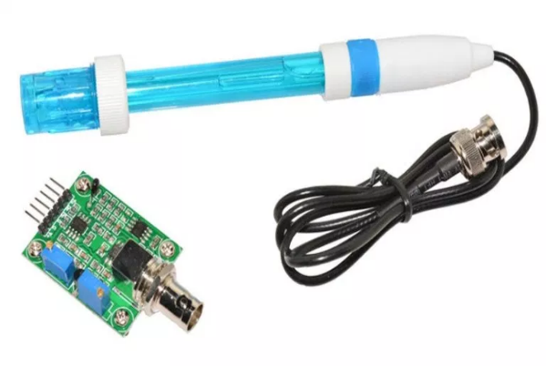
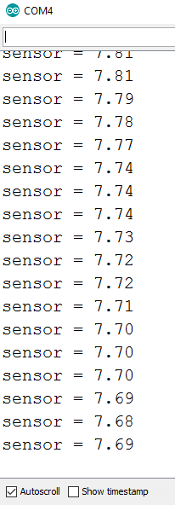
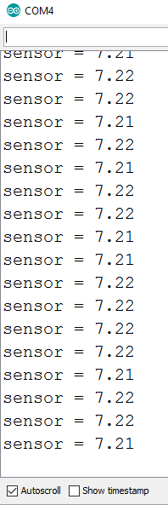
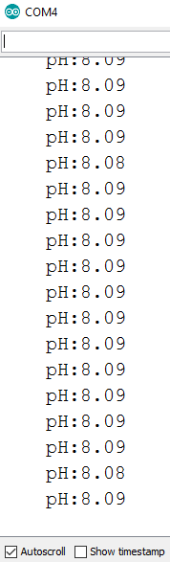
pH Sensor Testing at different Liquids
pH Sensor
Hardware Connection
Standard Value
Nestle Pure
Water bottle PH
Nestle
Milk Pack pH
Soap

Slide 8
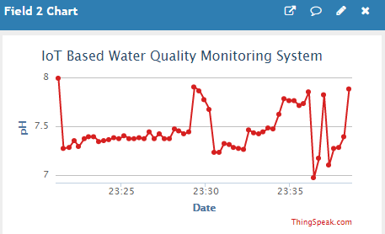
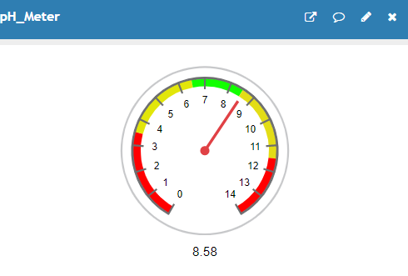
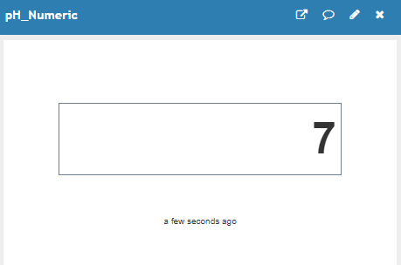
pH ThingSpeak Dashboard
pH Sensor Values can be visualized and analyzed on the Thingspeak dashboard using graph, gauge & numeric display
Graph
Gauge
Numeric Display

Slide 9
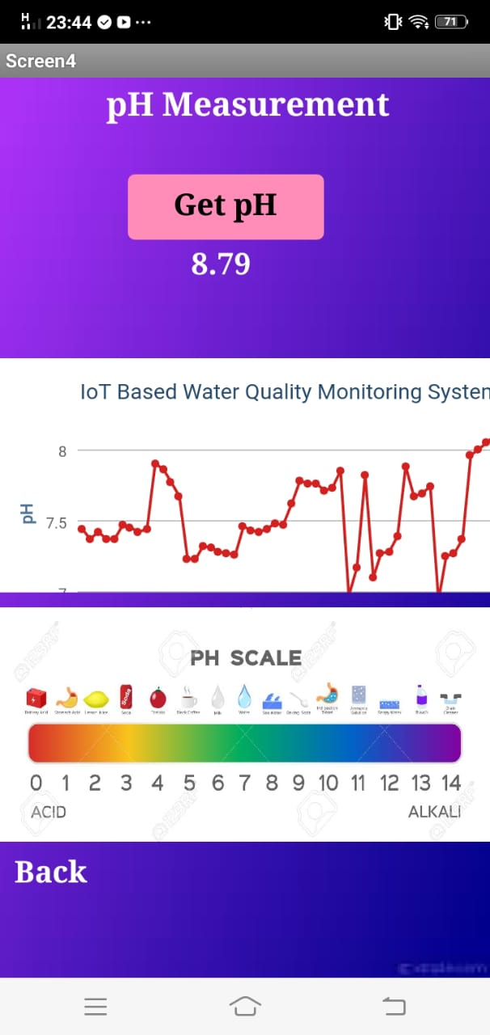
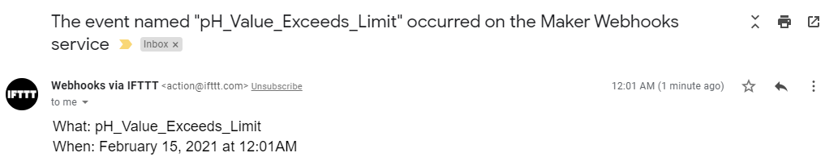
Android App
The pH reading can be monitored using the light weight user friendly Android App
By Using App we can
Visualized
Analyzed
Monitored
Compare Results with Standard Predefined values
Email Alert
When pH Limit Exceeds then
we are generating the
email alert

Slide 10
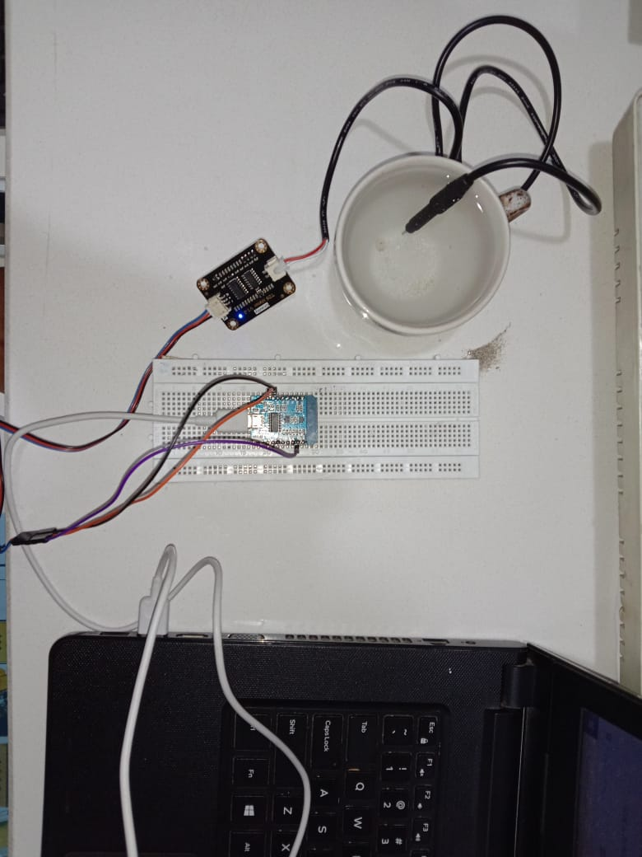
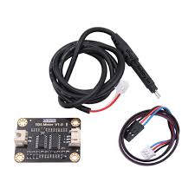
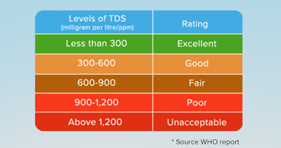
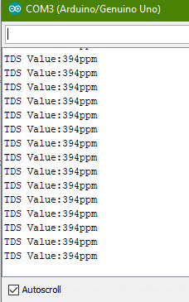
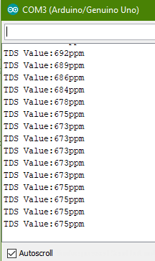
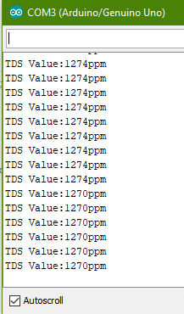
TDS Sensor Testing at different Salt levels
TDS Sensor
Hardware Connection
TDS Standard Value
TDS Result of
Drinking Water
TDS Result of
Less Salty Water
TDS Result of
Salty Water

Slide 11
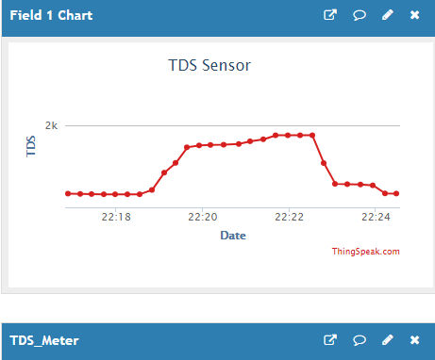
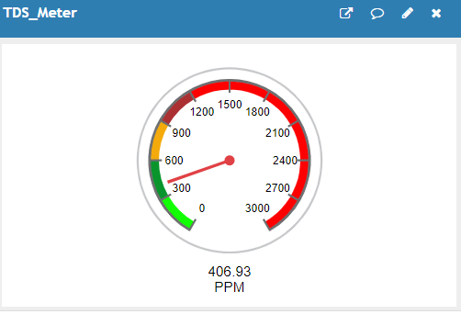
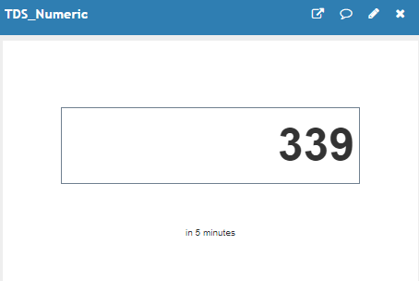
ThingSpeak Dashboard
TDS sensor readings can be monitored and analyzed on the Thingspeak dashboard using graph, gauge & numeric display
Graph
Gauge
Numeric Display

Slide 12
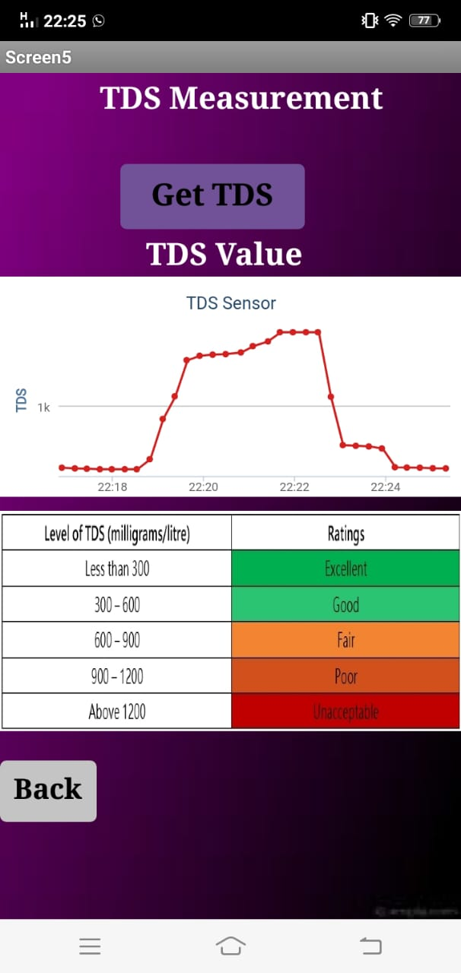
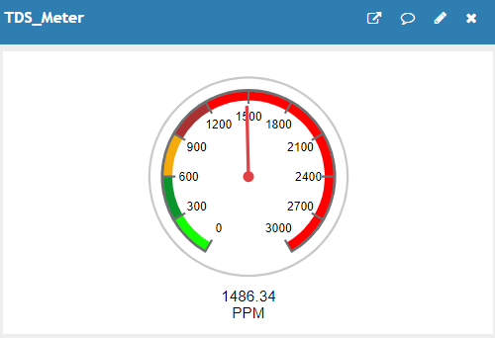
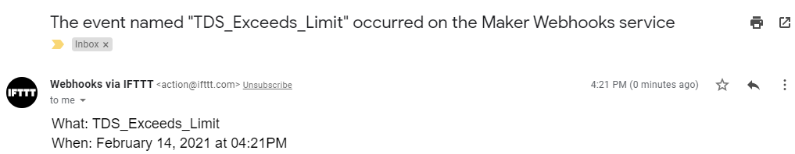
Android App Results & Email alert
The TDS reading can be monitored using the light weight user friendly Android App
By Using App we can
Visualized
Analyzed
Monitored
Compare Results with Standard Predefined values
When TDS Readings Exceeds
its Limit then we are generating
email alert

Slide 13
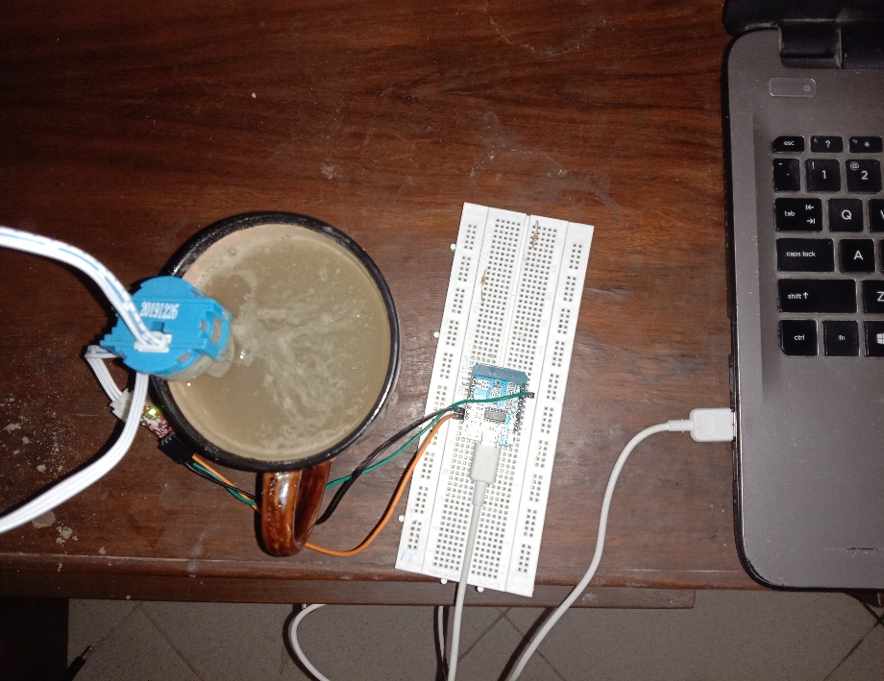
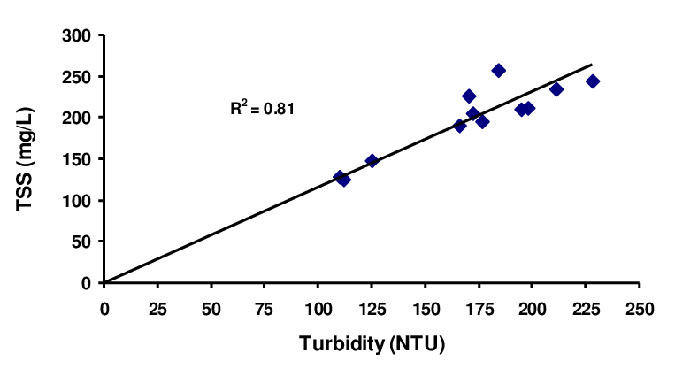
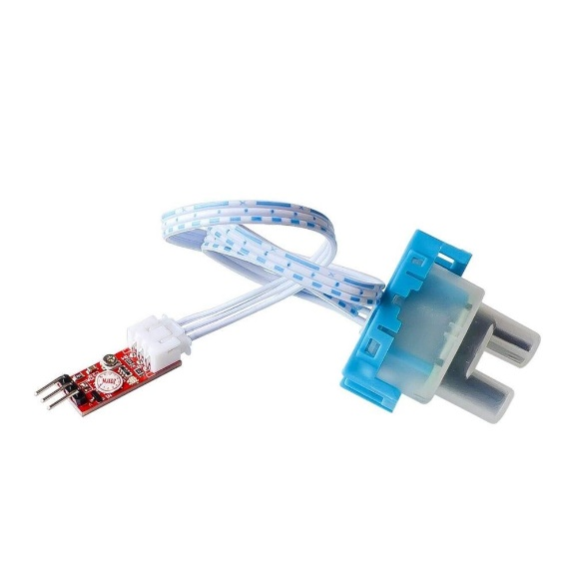
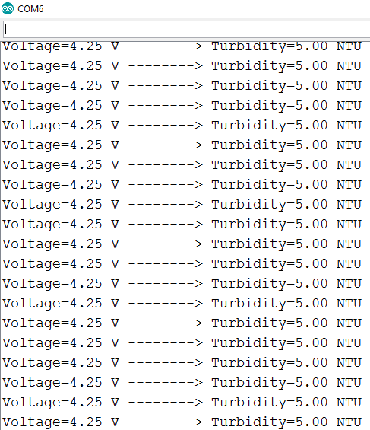
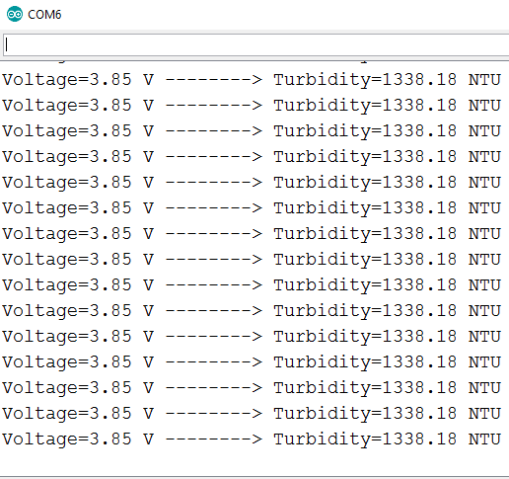
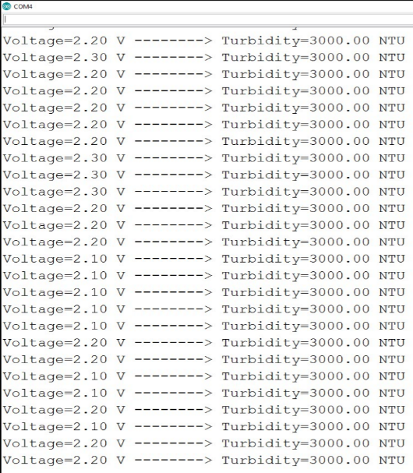
Turbidity Sensor Testing at different Liquids
Parameter | WHO
Turbidity(NTU) | <5
Turbidity
Level
Turbidity
Level
Drinking Water
Turbidity
Dirty Water
Turbidity

Slide 14
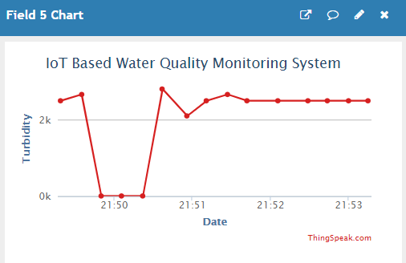
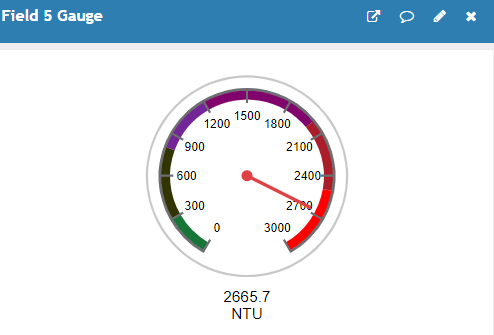
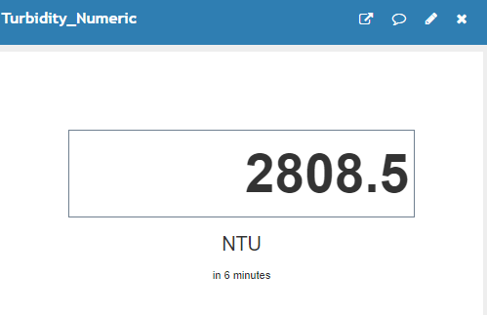
ThingSpeak Dashboard
Turbidity sensor readings can be monitored and analyzed on the Thingspeak dashboard using graph, gauge & numeric display
Gauge
Numeric Display
Graph

Slide 15
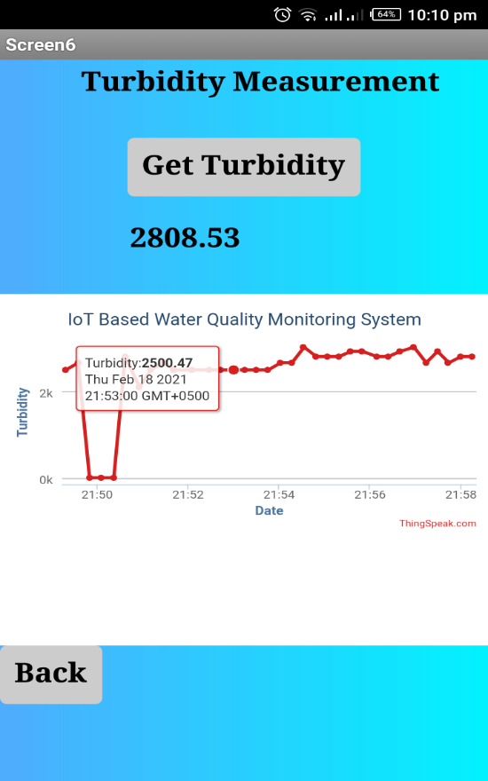
Android App
The pH reading can be monitored using the light weight user friendly Android App
By Using App we can
Visualized
Analyzed
Monitored
Compare Results with Standard Predefined values

Slide 16
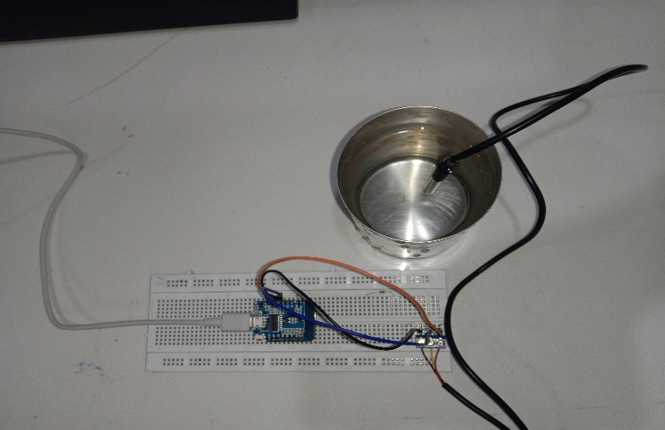
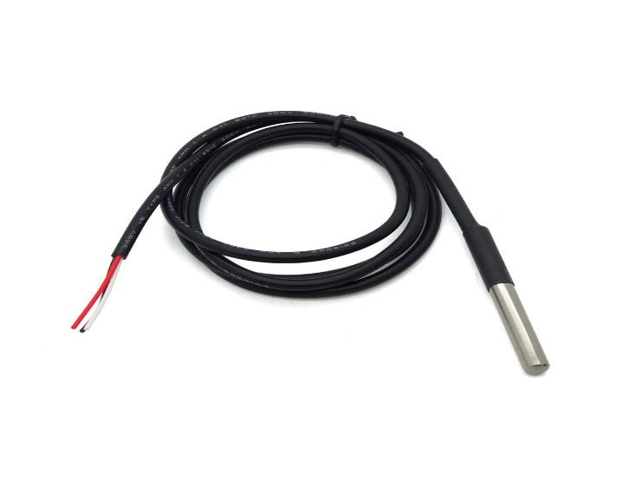
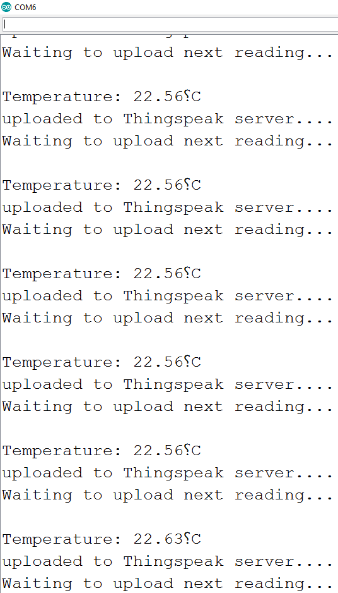
Temperature sensor Interfacing
Hardware Connection
DS18B20 waterproof Temperature Sensor
Temperature of Drinking Water

Slide 17
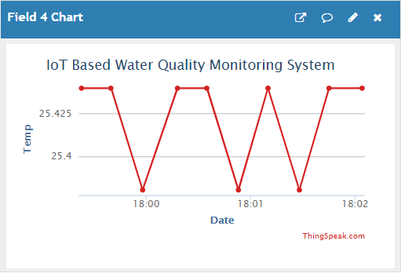
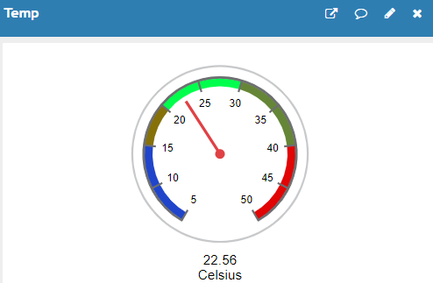
Temperature Sensor ThingSpeak Dashboard
Temperature Sensor Values can be visualized and analyzed on the Thingspeak dashboard using graph, gauge & numeric display
Gauge
Numeric Display
Graph

Slide 18
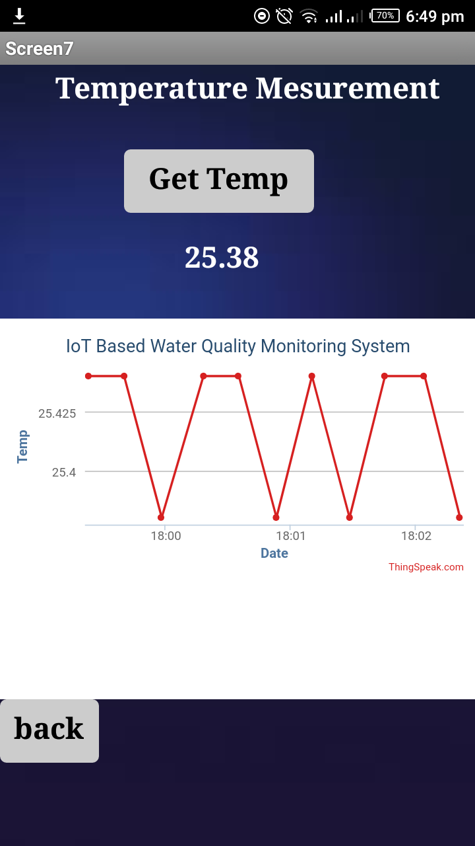
Android App
The pH reading can be monitored using the light weight user friendly Android App
By Using App we can
Visualized
Analyzed
Monitored
Compare Results with Standard Predefined values

Slide 19
Water Quality Test Results
Parameters | Standard value | Measured Value | Error | Accuracy
pH | 6.5-8.5 | 7.79 | 3.86% | 96.14%
Turbidity(NTU) | <5 | 5 | 4% | 96%
TDS(ppm) | <500(300 for Good Drinking water) | 394 | 23% | 77%
Standard Values: WHO Standard
Notes:
Error= (Measured-real)/real x 100
Accuracy= 100- percentage error

Slide 20
Android App

Slide 21
Future Tasks:
User Friendly Dashboard
Develop Prototype & Chassis
Compare Results with IBA Water Supply System
Add the triggering functionality
Work at Sensors Calibration(Precision & Accuracy)
Thesis Manuscript
Thesis Submission

Slide 22
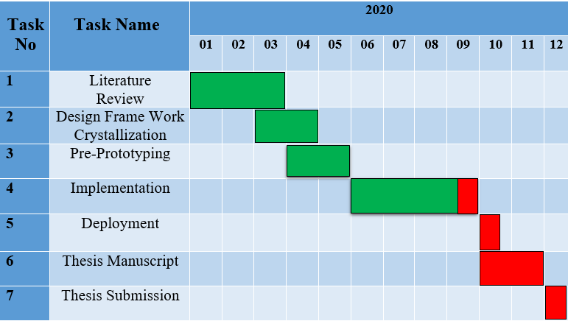
Gantt Chart
Green: Completed task
Red: Future task

Slide 23
References
https://ieeexplore.ieee.org/document/8821742
https://ieeexplore.ieee.org/abstract/document/9052289
https://ieeexplore.ieee.org/document/9117271
https://ieeexplore.ieee.org/abstract/document/9020583
https://ieeexplore.ieee.org/document/9242798
http://pep.ijieee.org.in/journal_pdf/11-247-146244659544-48.pdf
https://ijisrt.com/wp-content/uploads/2018/04/IoT-Based-Real-time-water-Monitoring-System-for-Smart-City.pdf
https://www.ripublication.com/awmc17/awmcv10n5_24.pdf
https://www.sciencedirect.com/science/article/pii/S1877050919309391
https://www.sciencedirect.com/science/article/pii/S2405844020309403
https://www.iotacommunications.com/blog/smart-water-quality-monitoring-system-using-iot/

Slide 24


